Slide 1
Tutorial 1 - Week 2
We’ll be starting at the 10 minute mark

Slide 2
Agenda
TA Introductions
Logistics
Introduction to Wing 101 IDE
Programming concepts: types, variables, operators, expressions, errors
Practice problems
Questions?

Slide 3

Introduction - TA
Ali Howidi
(TUT# + TUT#)
Current studies: Second year MASc BME student
Research/other interests: Signal analysis and machine learning for biosignals

Slide 4
Tutorial Logistics
Tutorials are for your benefit - no grading
We will review previous weeks labs & lecture content
Be sure to ask lots of questions and have Python open. We are here to help you!
Questions outside of tutorial time?
Post to Piazza - all TAs/instructors and your peers can answer questions quickly
Coffee Time – drop-in hours for 1on1 help

Slide 5

Coffee Time With TAs!
These are hours for any extra help you need for the course or programming in general 🙂
also known as office hours
Please go to the following link to submit your response.
https://forms.gle/4NeZXciXTnUBZFTQ7

Slide 6
Virutal Tutorial and Virutal Labs! !
Please go to the following links to submit your response.
Tutorial:
https://forms.gle/CPC5waK4m4wJgQnp9
Labs:
https://forms.gle/2GrSNK7BoNPafjYr7

Slide 7
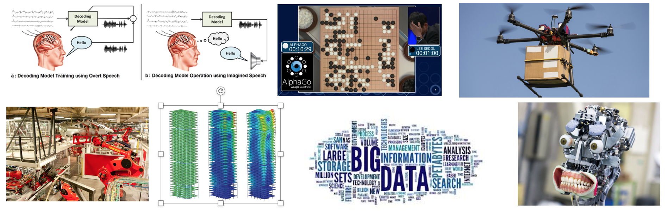
Why code?¹
Programming is awesome!
Computers are everywhere, programming is a boundless opportunity
Software engineering can be applied to almost any context in the world

Slide 8
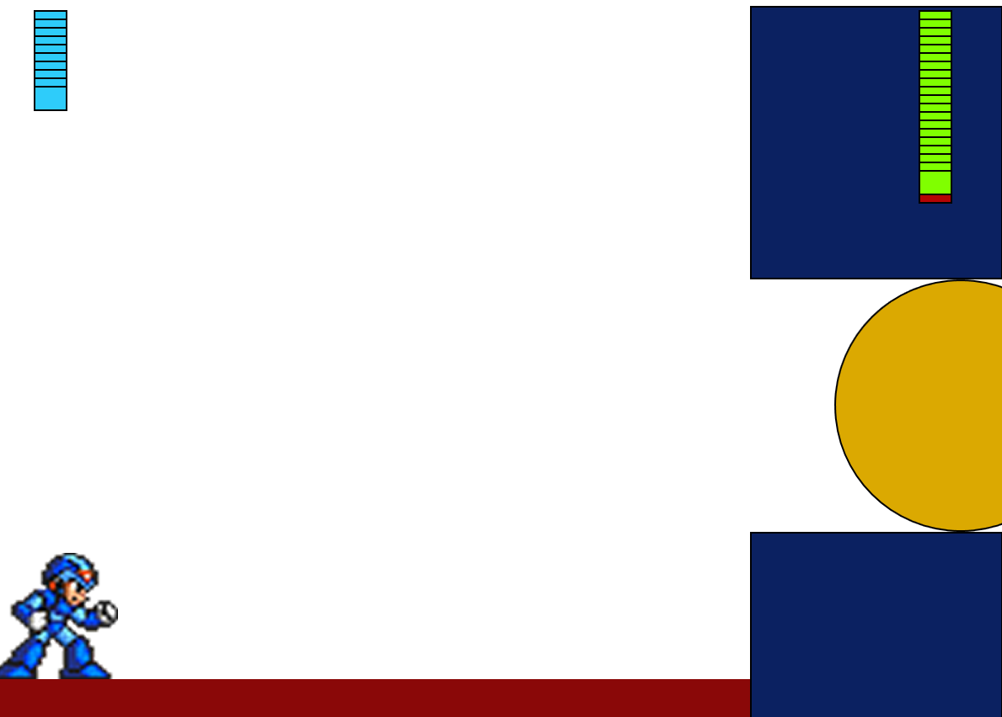
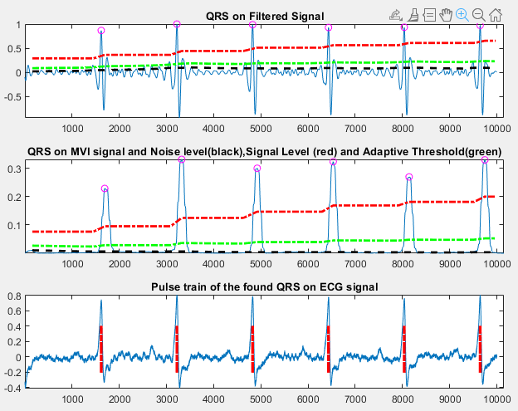
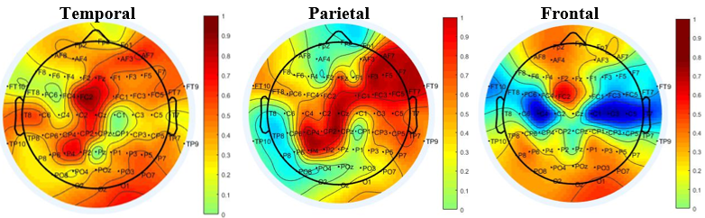
Why code?²
Regardless of background, coding is always an achievable skill
Software engineering can be applied to almost any context in the world
NEVER THINK THAT YOU “CAN'T UNDERSTAND” CODING
Notes:
Replace with your figures

Slide 9

What would you want to ideally learn how to do with computers?

Slide 10


What would you want to ideally learn how to do with computers?
ⓘ Start presenting to display the poll results on this slide.

Slide 11
Coding experience?

Slide 12

How would you rate your coding experience
ⓘ Start presenting to display the poll results on this slide.

Slide 13
Intro to Wing 101 IDE

Slide 14
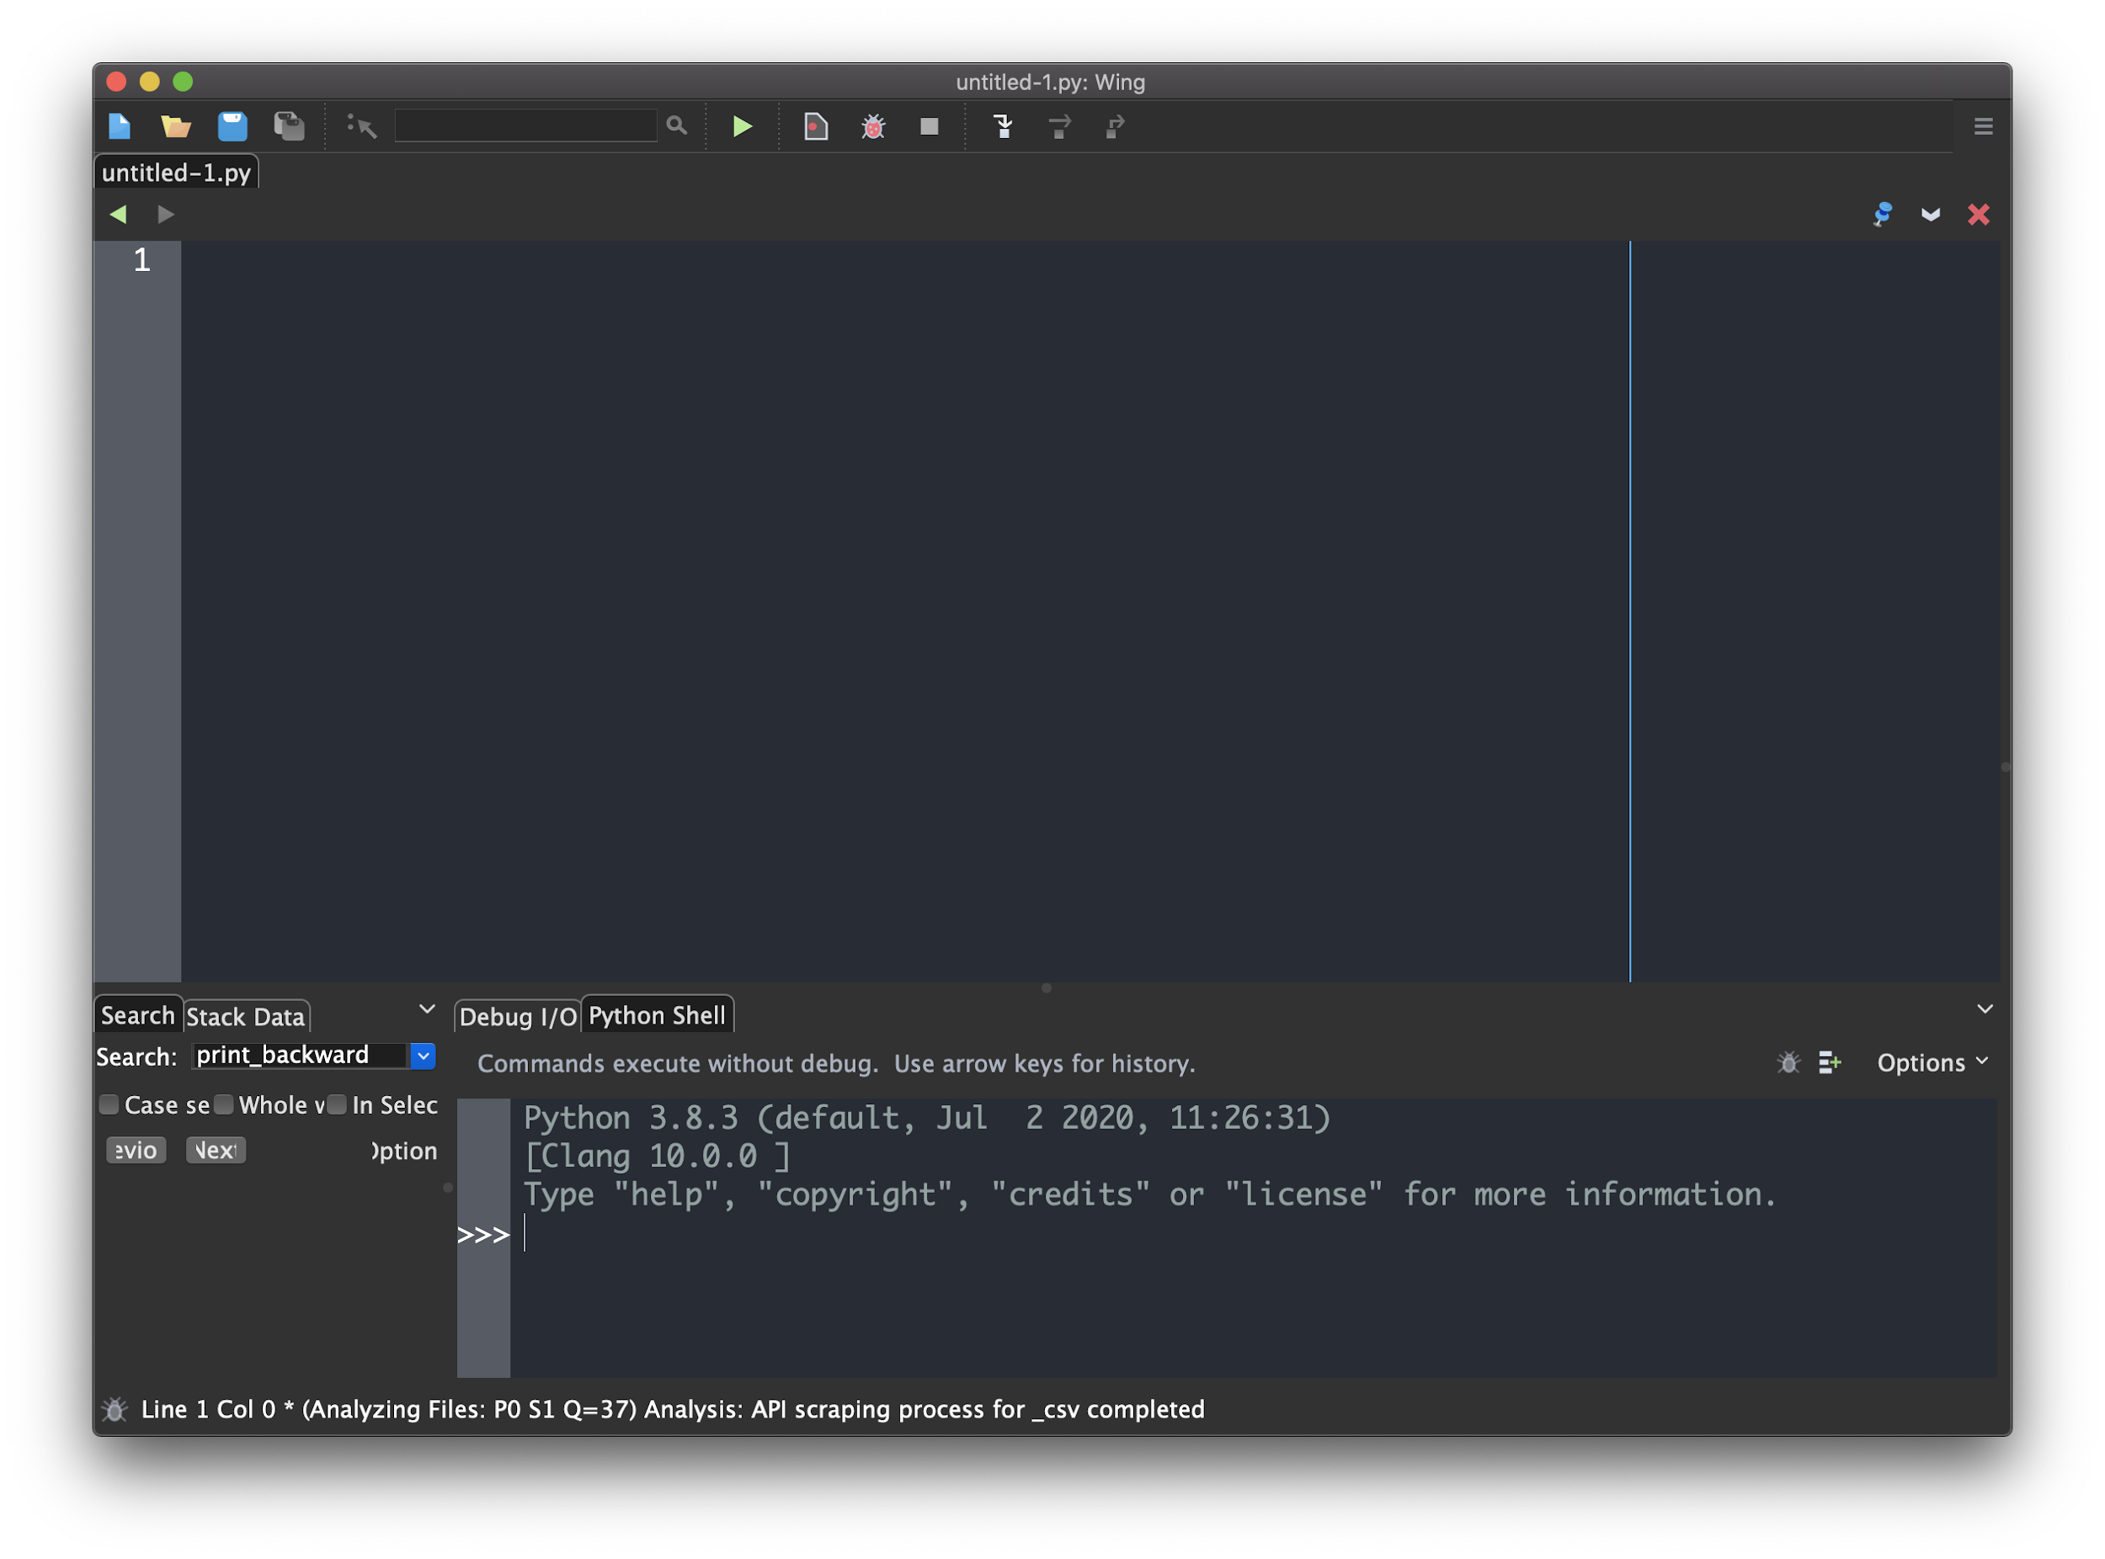
Wing101
Wing 101 is an Integrated Development Environment
Script/program editing window
Python Shell

Slide 15
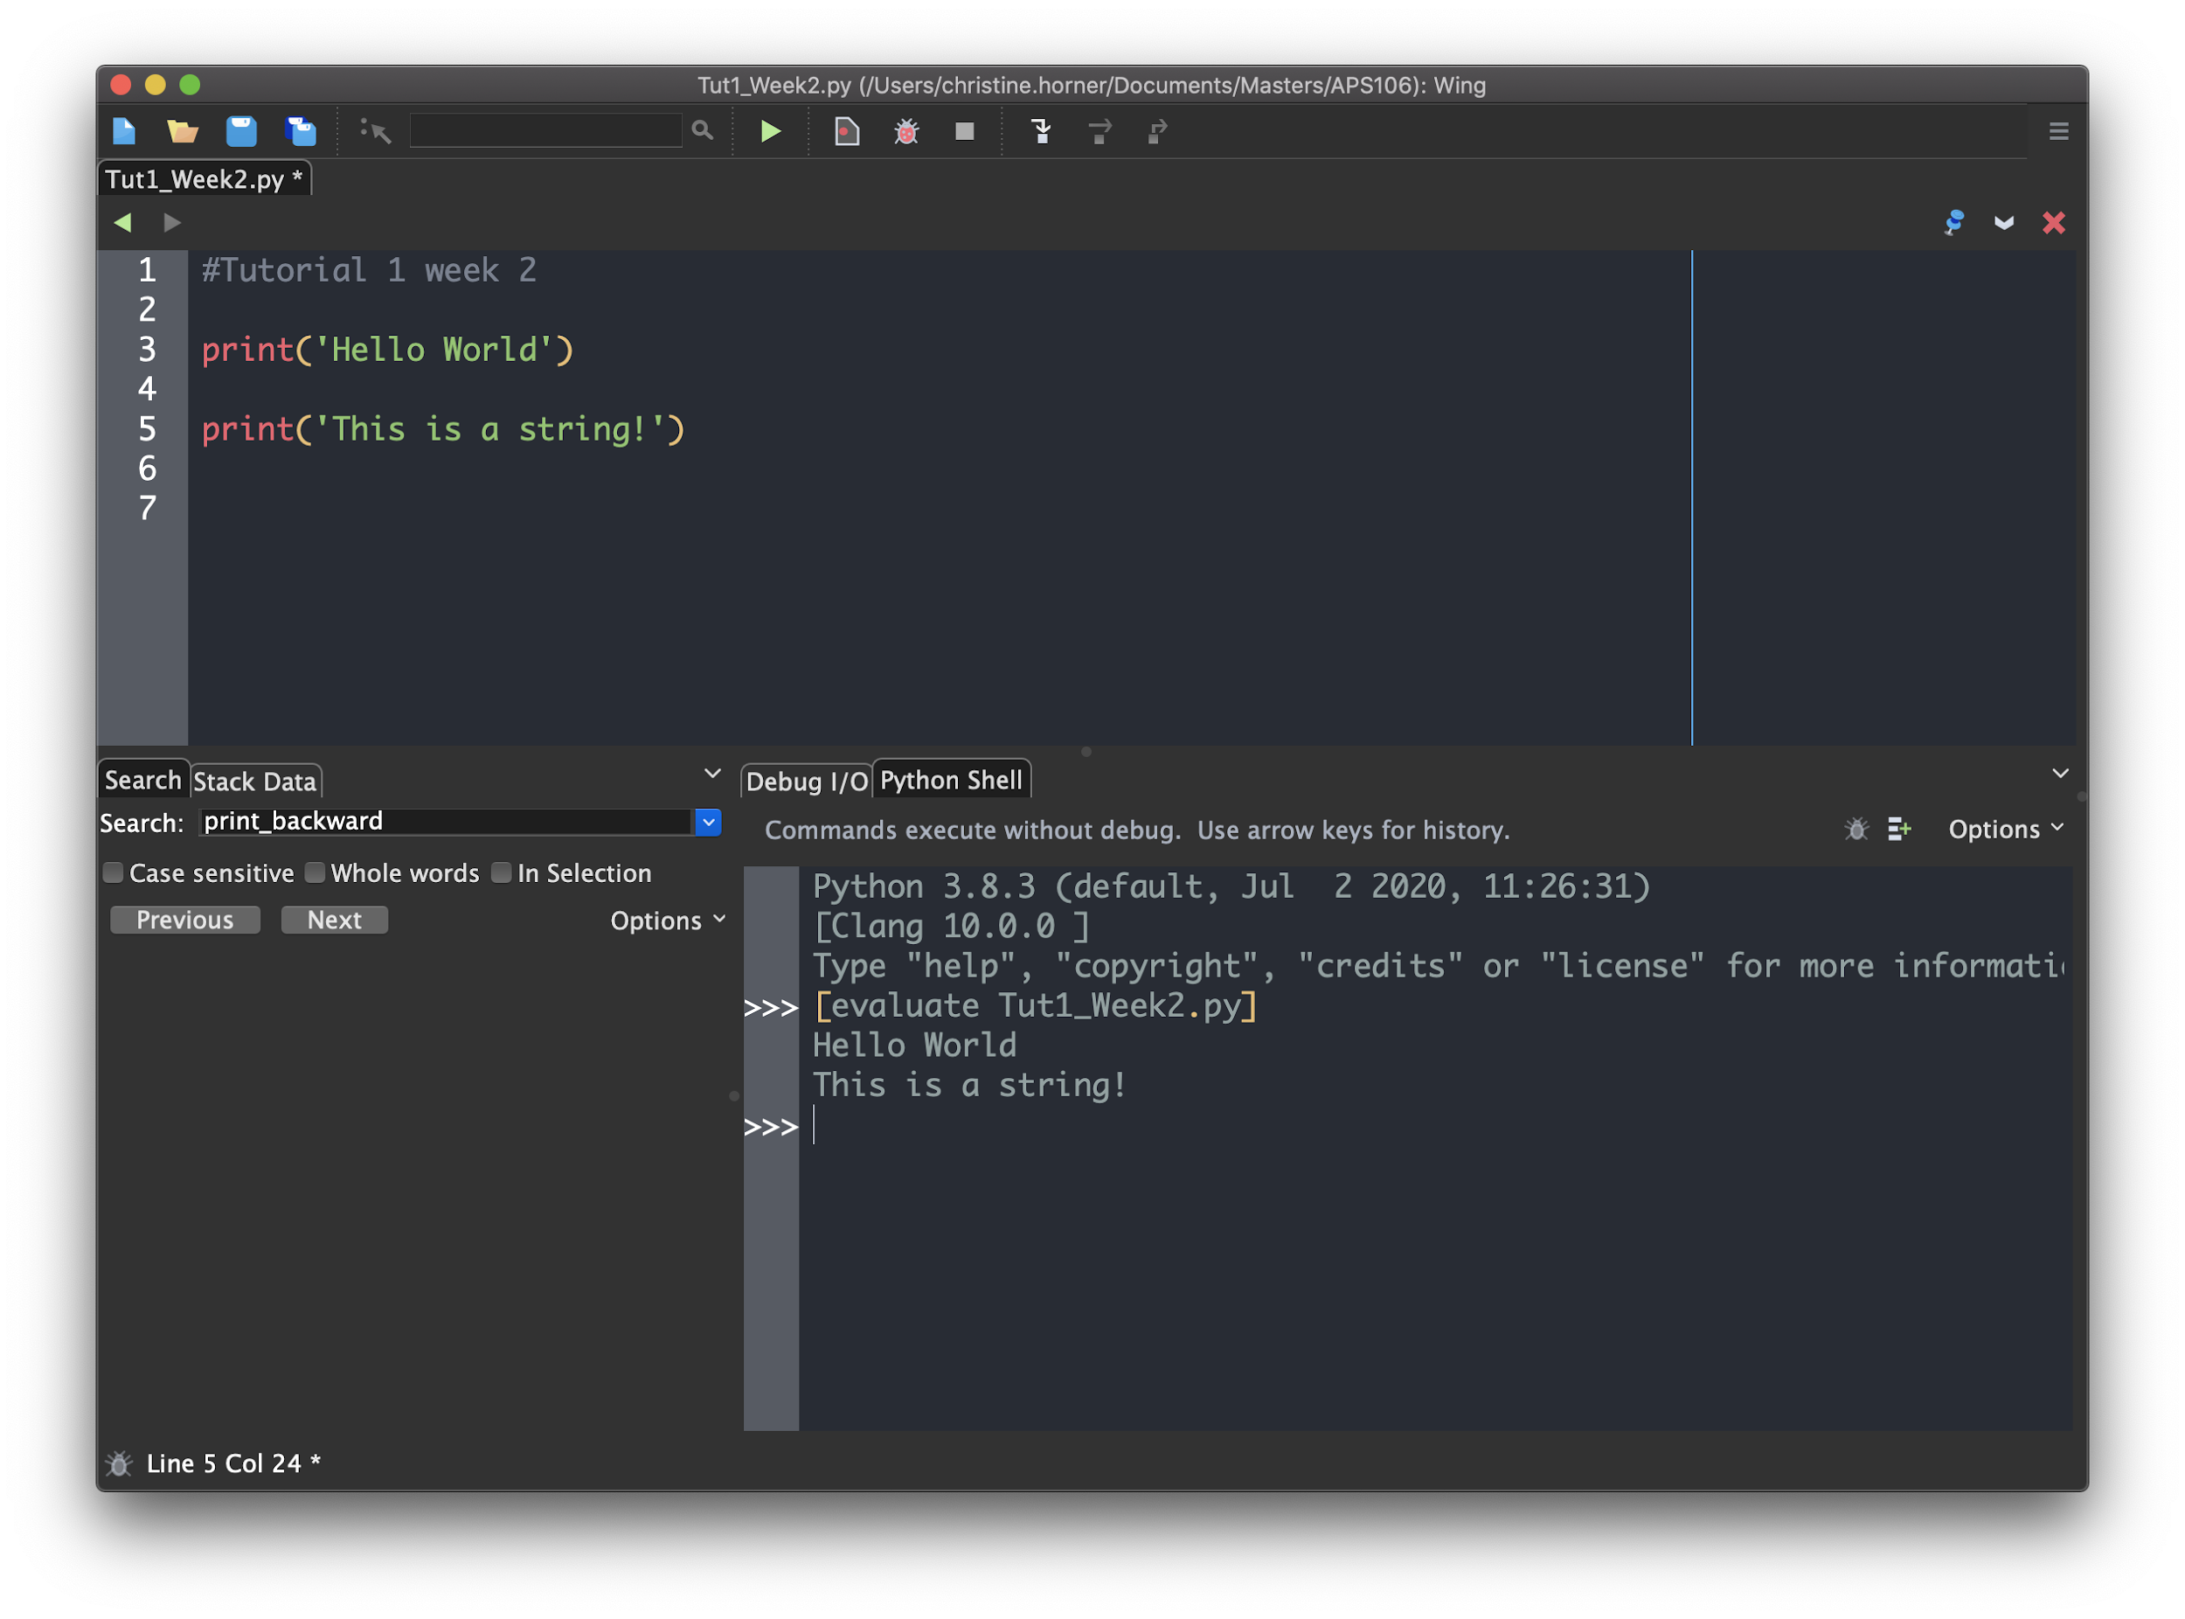
Click on the green chevron to run your code
Script Name
Single-line comments. They start with a “#”
Tip: Use these to make your script easier to follow
Statements that will be executed
Python version in use. Make sure you are using Python3 !
Python code can be written and run directly in the shell

Slide 16
Programming Concepts
Values, Types, and Variables

Slide 17
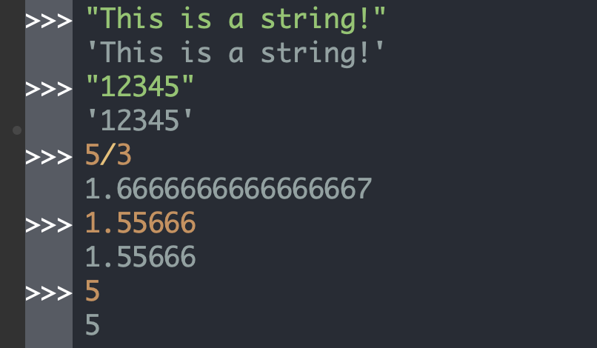
Values and Types in Programming
Value: the representation of some entity that can be manipulated by a program, e.g., 5.
Type: a set of values and the operations that can be performed on those values
Examples of Python types and values:
int: the set of integer numbers
sample value:
float: the set of (double-precision) floating-point numbers
sample value:
str: the set of sequences of characters
sample values:

Slide 18
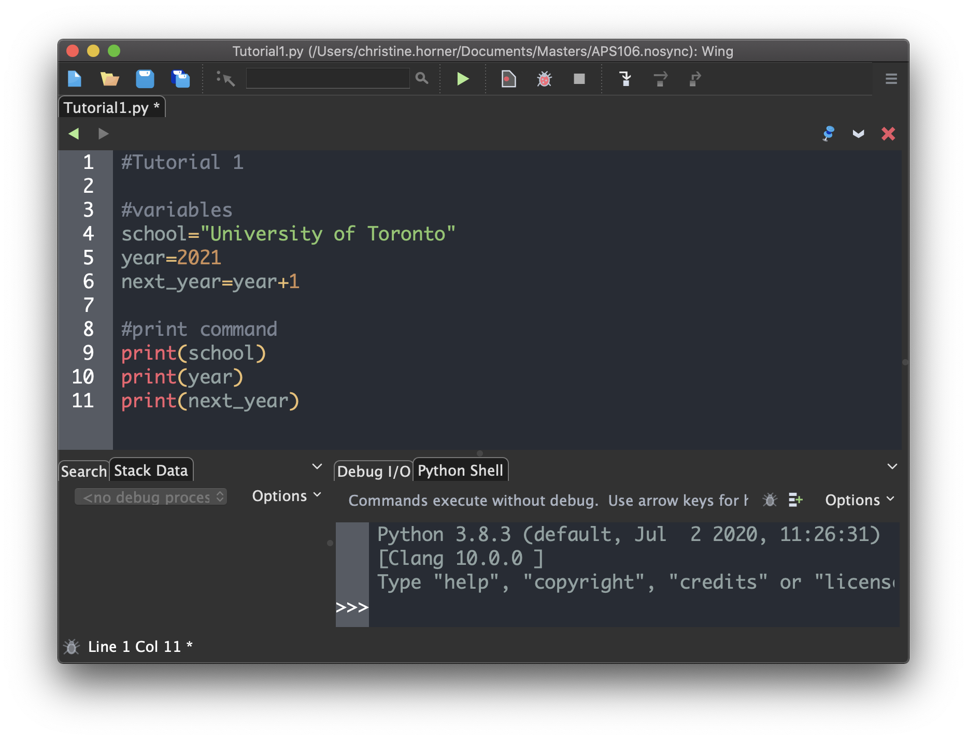
Variables
A variable is a “container” for a value.
Variables are associated with values via assignment statements.
assignment statements in Python: variable_name = expression
In Python:
variable names must:
start with a letter or _
contain only letters, digits or _
variables have types (a variable has the type of the value assigned to it)
Tip: use meaningful variable names !

Slide 19
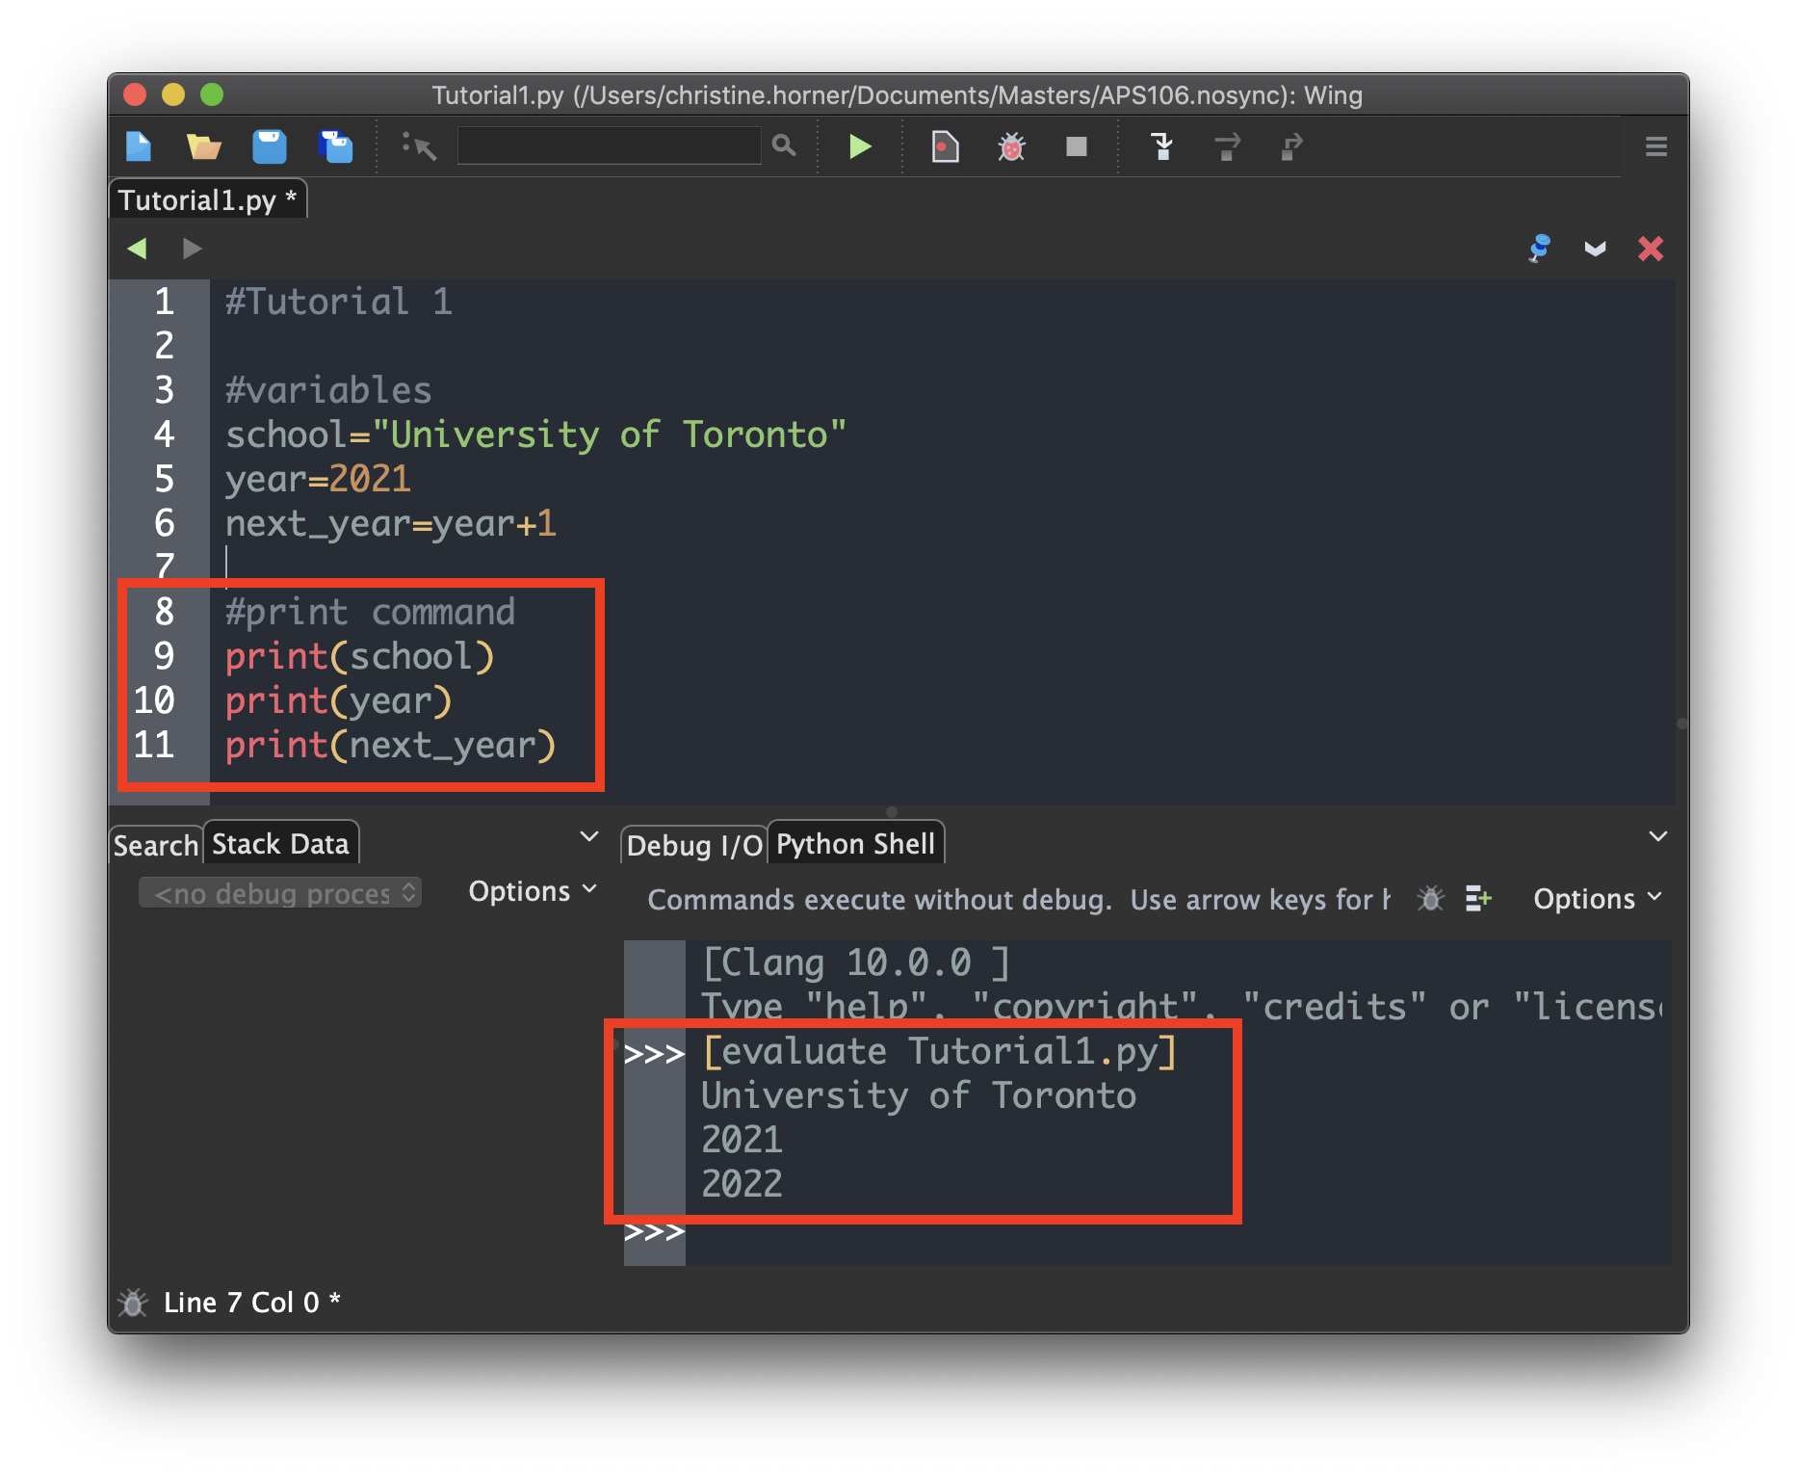
Python Function print()
In Python, we can use the built-in function print()to display objects/values in the shell.
In particular, we can use print() to display the value of program variables.
TO DO: run this code with and without
the print statements.

Slide 20
Programming Concepts
Operators and Expressions

Slide 21
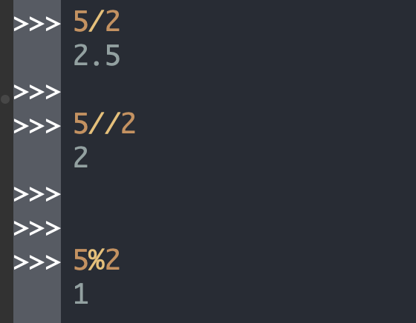
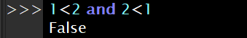
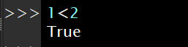
Operators - Basics
Operators are programming constructs that generally behave like functions.
An operator is, generally, represented by a symbol, e.g.: +, /, -, //, %, <,==,>,and
Type | Name | Symbol | Operand Data Type(s) | Arity
arithmetic | integer division | // | Number | binary
arithmetic | modulo | % | Number | binary
relational | less than | < | various types | binary
logical | logical conjunction | and | all data types | binary
Examples of Python operators
Do not worry about these 2 for now

Slide 22
Expressions
An expression is a combination of values (literals), variables, operators, and parentheses.
Python Examples of Simple Arithmetic Expressions | English description | Result
11 + 3 | 11 plus 3 | 14
5 - 19 | 5 minus 19 | -14
7 * 4 | 7 multiplied by 4 | 28
2 ** 5 | 2 to the power of 5 | 32
9 / 2 | 9 divided by 2 | 4.5
9 // 2 | 9 divided by 2 | 4
9 % 2 | 9 mod 2 | 1
Python Operator (symbol) | Name (Operation)
+ | addition
- | subtraction
* | multiplication
** | exponentiation
/ | division
// | integer division
% | modulo (remainder)
An arithmetic expression is an expression that contains numerical values, arithmetic operators and parentheses.
The operators in an un-parenthesized arithmetic expression are evaluated in order of precedence.

Slide 23
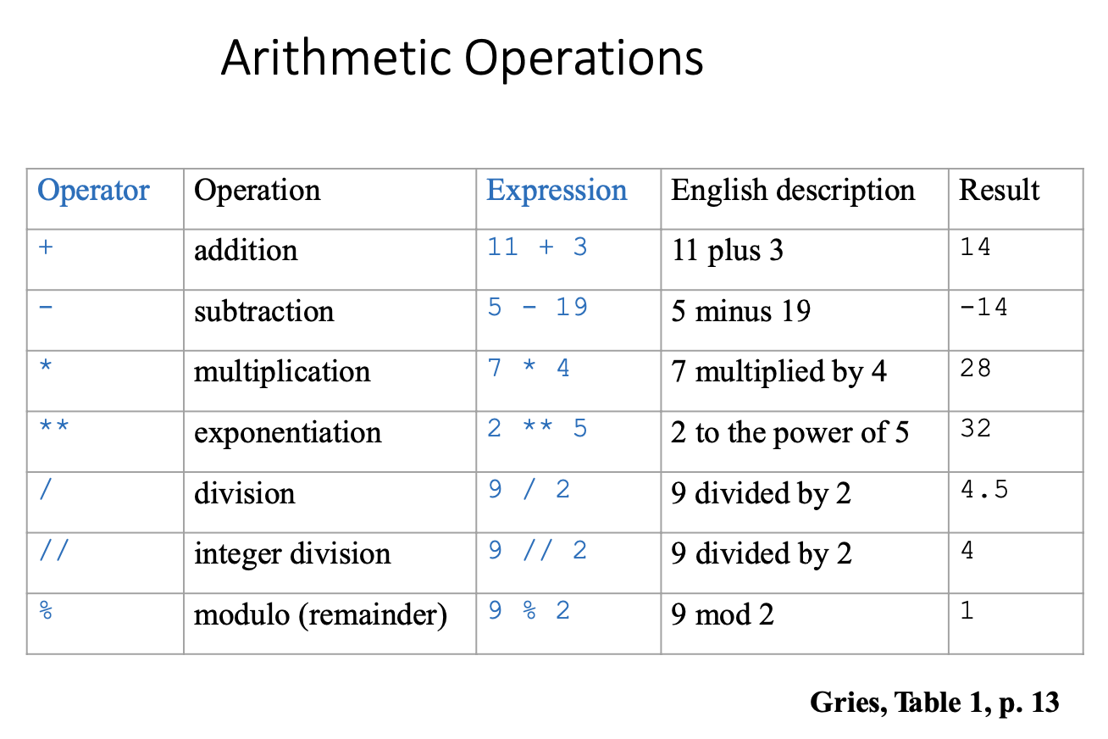
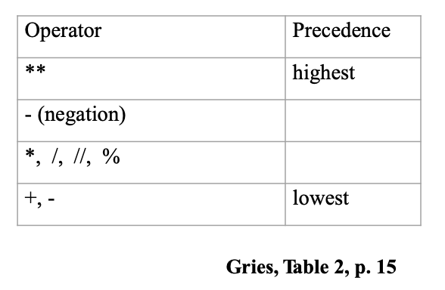
Arithmetic Expressions
Arithmetic expressions follow the same rules learned in math class!
The operators in an un-parenthesized expression are evaluated in order of precedence.

Slide 24
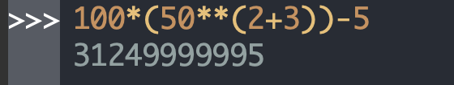
Operator Precedence
Operator | Precedence
** | highest
- (negation)
*, /, //, %
+, - | lowest
Operator precedence, or the order of operations, is a collection of rules about which actions to perform first in order to evaluate a given expression.
For example, in all programming languages, the arithmetic operators, e.g., multiplication, division, integer division, modulo, addition, subtraction, are evaluated according to the order of precedence of their corresponding math operators.
Precedence rules for other operators, e.g., relational operators, are language-dependent !

Slide 25
Give it a try! Arithmetic Operation Examples
Integer division: //
Modulo: %
Arithmetic Precedence

Slide 26
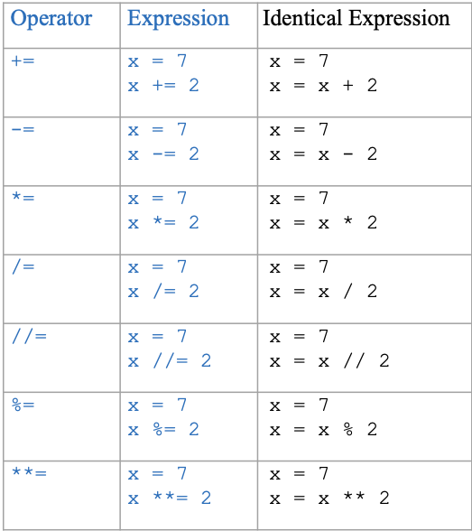
Augmented Operators in Python

Slide 27
Programming Concepts
Errors

Slide 28
Error Types¹
Name | Definition | Timing | Python Examples
Syntax error | An error due to the code not being syntactically valid (i.e., not obeying the grammar of the programming language) | Usually discovered during compilation | >>> (3 + 2 * 4 Syntax Error: unmatched ')’ Expression (3 + 2 * 4 contains an open parenthesis but not a corresponding close parenthesis
Semantic error | An error due to the code not following the semantic rules of a programming language, e.g., when operators are used improperly or when an attempt is made to use a variable that has not yet been associated with a value, or | Usually discovered during compilation | >>> "Hello" - 4 TypeError: unsupported operand type(s) for -: 'str' and 'int’ Operator - cannot be applied to a string and an integer >>> a > 5 NameError: name 'a' is not defined

Slide 29
Error Types²
Name | Definition | Timing | Python Examples
Runtime Error | An error that occurs during the execution (runtime) of a program. | Happens when the code is run, and may halt the execution of the program | >>> a = 5 >>> b = 4 /(a - 5) ZeroDivisionError: division by zero
Logical Error | An error that results from the code not conforming to its intended semantics due to, e.g., a formula being implemented incorrectly, a block of code being indented erroneously, the programmer misunderstanding and implementing incorrectly a requirement. | Happens when the code is run. May remain undiscovered. | >>> duration_in_seconds = duration_in_hours * 100 The formula for converting hours into seconds is incorrect

Slide 30
Practice Problems

Slide 31

What does the following code output?
ⓘ Start presenting to display the poll results on this slide.

Slide 32
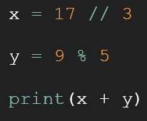
Review Practice Problem 1
What does the following code output?
7.47
9
5 4
6
None of the above

Slide 33
What does the following code output?
ⓘ Start presenting to display the poll results on this slide.

Slide 34
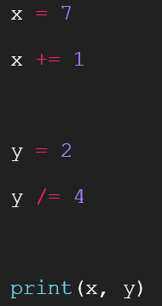
Review Practice Problem 2
What does the following code output?
1 4
7 2
1 0
8 0.5
None of the above

Slide 35
What is the outcome of running this code?
ⓘ Start presenting to display the poll results on this slide.

Slide 36
Review Practice Problem 3
What is the outcome of running this code?
'This is midterm 1'
This is midterm 1
Logical error
Semantic error
Syntax error

Slide 37
What is the outcome of running this code?
ⓘ Start presenting to display the poll results on this slide.

Slide 38
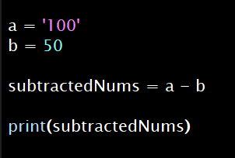
Practice Problem 4
What is the outcome of running this code?
A logical error occurs
50
A runtime error occurs
A semantic error occurs
A syntax error occurs

Slide 39
What is the outcome of running this code?
ⓘ Start presenting to display the poll results on this slide.

Slide 40
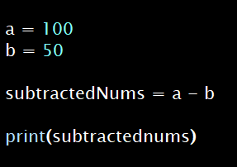
Practice Problem 5
What is the outcome of running this code?
A logical error occurs
50
A runtime error occurs
A semantic error occurs
A syntax error occurs
NOTE! print() must have a valid parameter inside
Notes:
Emphasise that something has to be inside

Slide 41
Learning Objectives
Upon completing this tutorial, the students will be able to:
use Wing 101 effectively
understand the concept of value / type / variable / operator / expression / error
recognize values / types / variables / operators / expressions / errors
define values (literals) / variables
use values, variables and operators (to define expressions)
evaluate simple expressions
fix basic errors
Notes:
Put this before questions?

Slide 42

Any questions?
ⓘ Start presenting to display the poll results on this slide.

